Slide 1

Java Web Services

Slide 2

Table of Contents
What is Web Services?
Examples of Web Services
What are the different type of Web Services?
Difference between REST & SOAP
Spring Boot
Spring Initialzr
Creating our first REST Web Service
Creating our first Application with REST Web Service
Database Integration using JPA

Slide 3

Introduction to Web Services
What is a Web Service?
A web service is any piece of software that makes itself available over the internet and uses a standardized XML messaging system.
For example, a client invokes a web service by sending an XML message, then waits for a corresponding XML response.
As all communication is in XML, web services are not tied to any one operating system or programming language—Java can talk with Perl; Windows applications can talk with Unix applications.
Web services are self-contained, modular, distributed, dynamic applications that can be described, published, located, or invoked over the network to create products, processes, and supply chains. These applications can be local, distributed, or web-based.
A web service is a collection of open protocols and standards used for exchanging data between applications or systems.
A web service is a kind of webified application—an application typically delivered over HTTP (HyperText Transport Protocol). HTTPS (HTTP Secure) adds a security layer to HTTP; hence, a service delivered over HTTPS likewise counts as a web service.

Slide 4
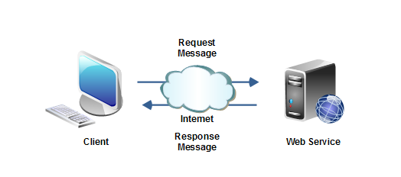
Introduction to Web Services
Web services can be programmed in a variety of languages, old and new.
A web service is a distributed software system whose components can be deployed and executed on physically distinct devices.

Slide 5

Introduction to Web Services
3 keys to remember
Designed for machine-to-machine(or application-to-application) interaction
Should be interoperable -- Not platform dependent
Should allow communication over a network

Slide 6
Introduction to Web Services
Some examples of Web Services
A route finder that provides an optimal route between two or more locations in the form of directions or a map
A service that locates synonyms for a given word
A stock quote service that provides stock prices, updated every 15 minutes
An online dictionary
A weather service
An online shopping applications

Slide 7
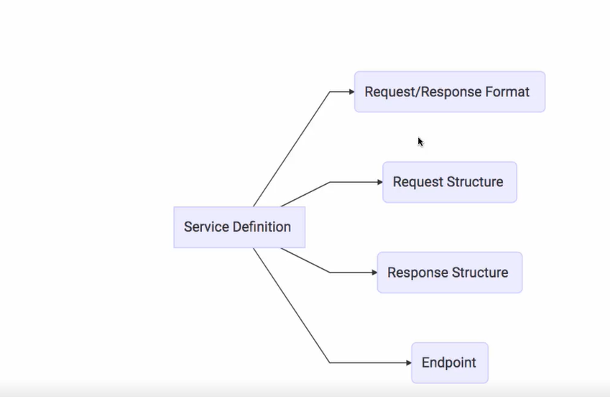
Introduction to Web Services
Key Terminologies
Request and Response
Request -- input to web service
Response -- output from web service
Message Exchange Format
This is the format of the request and the response(XML, JSON.. etc)
Service Provider or server
Hosts the web service / Provides the services
Service Consumer or Client
Uses the service
Service Definition
Contract between the server and the client

Slide 8

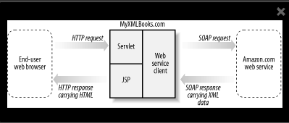
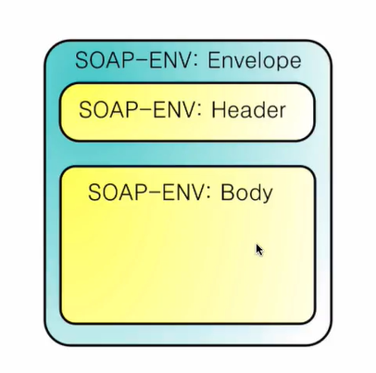
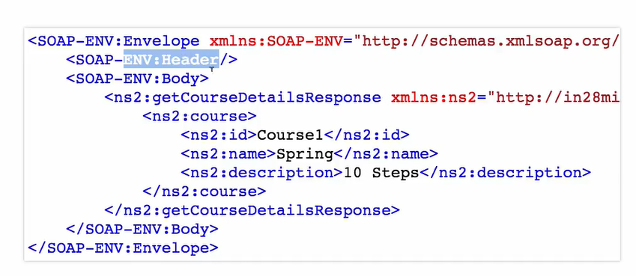
Introduction to Web Services
SOAP (Simple Object Access Protocol)
SOAP is an XML dialect with a grammar that specifies the structure that a document must have in order to count as SOAP.
In a typical SOAP-based service, the client sends SOAP messages to the service and the service responds in kind, with SOAP messages.

Slide 9

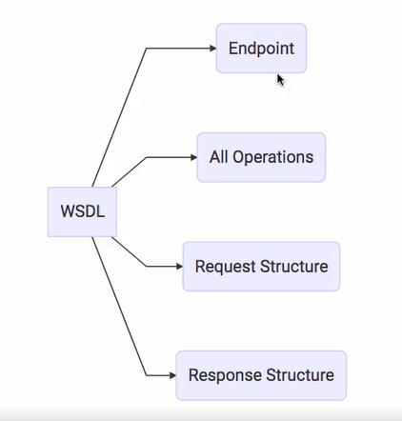
Introduction to Web Services
SOAP characteristics
Request/Response Format - SOAP XML format
Communicates over HTTP and MQ
Service Definition - is defined by using WSDL(Web Service Definition Language)

Slide 10
Introduction to Web Services
REST(REpresentational State Transfer)
REST is web standards based architecture and uses HTTP Protocol.
It revolves around resource where every component is a resource and a resource is accessed by a common interface using HTTP standard methods.
Makes use of HTTP Methods to determine what type of action to do (GET, POST, PUT, DELETE...)
Uses HTTP status codes to determine the status of the response to the client (1xx,2xx,3xx,4xx,5xx)
Uses URI (Uniform Resource Identifier) - primary data representation. It is a unique identifier for the resources in an application
/user
/user/{1}
/books

Slide 11
Introduction to Web Services
Constructing a Standard URI
The following are important points to be considered while designing a URI −
Use Plural Noun − Use plural noun to define resources. For example, we've used users to identify users as a resource.
Avoid using spaces − Use underscore (_) or hyphen (-) when using a long resource name. For example, use authorized_users instead of authorized%20users.
Use lowercase letters − Although URI is case-insensitive, it is a good practice to keep the url in lower case letters only.
Maintain Backward Compatibility − As Web Service is a public service, a URI once made public should always be available. In case, URI gets updated, redirect the older URI to a new URI using the HTTP Status code, 300.
Use HTTP Verb − Always use HTTP Verb like GET, PUT and DELETE to do the operations on the resource. It is not good to use operations name in the URI.

Slide 12
Introduction to Web Services
The five important constraints for RESTful Web Service are
Client - Server : There should be a service producer and a service consumer.
The interface (URL) is uniform and exposing resources.
The service is stateless.
The service results should be Cacheable. HTTP cache, for example.
Service should assume a Layered architecture. Client should not assume direct connection to server - it might be getting info from a middle layer - cache.

Slide 13

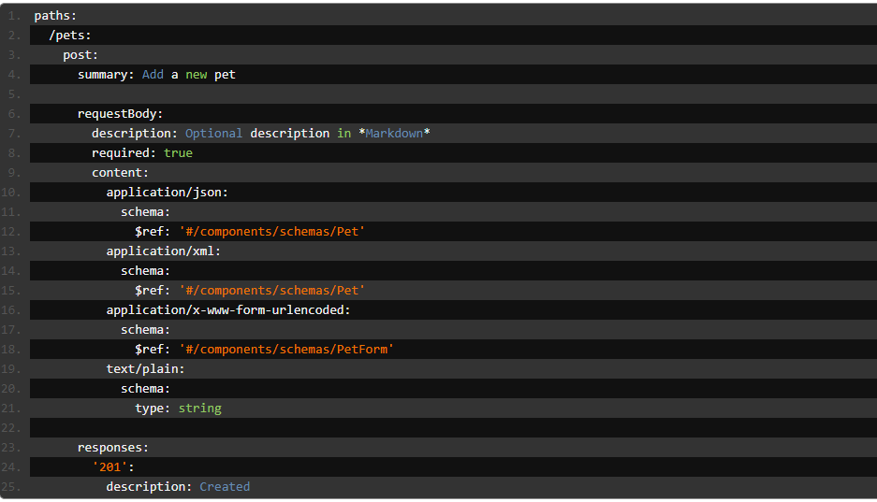
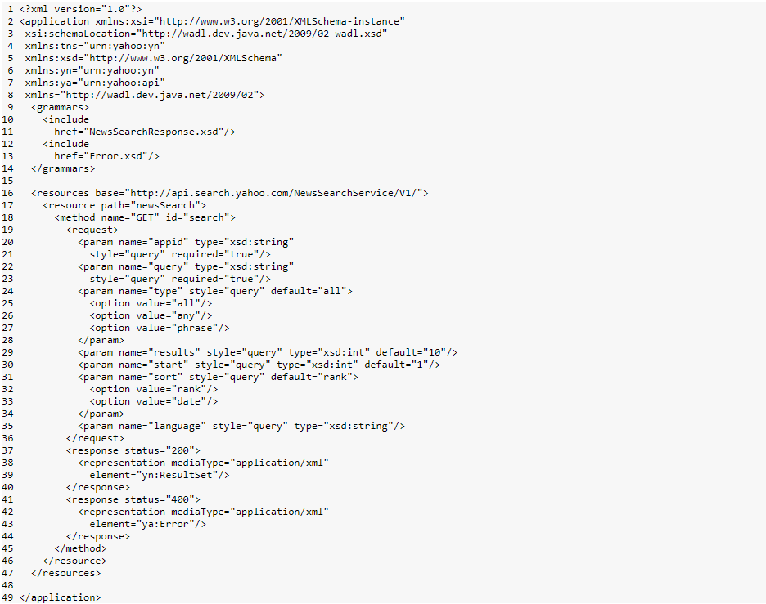
Introduction to Web Services
REST Characteristics
Request/Response Format - No restrictions. Can be plain texts, XML, HTML, JSON. JSON is the most popular.
Communicates over HTTP
Service Definition - is defined by using WADL (Web Application Definition Language) or Swagger

Slide 14
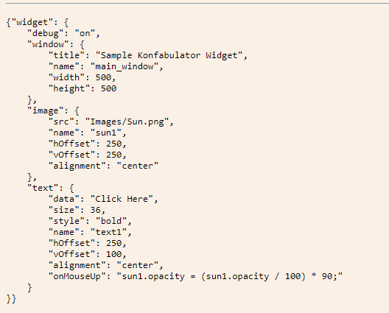
Introduction to Web Services
JavaScript Object Notation (JSON)
is a lightweight data-interchange format
It is easy for humans to read and write
It is easy for machines to parse and generate
An object is an unordered set of name/value pairs. An object begins with {left brace and ends with }right brace. Each name is followed by :colon and the name/value pairs are separated by ,comma.

Slide 15
Introduction to Web Services
SOAP
REST
SOAP stands for Simple Object Access Protocol.
SOAP defines standards to be strictly followed.
Data Exchange Format - SOAP XML
Service Definition - Uses WSDL (Required)
Transport - HTTP & MQ
SOAP defines its own security.
REST stands for REpresentational State Transfer.
REST does not define too much standards like SOAP.
Data Exchange Format - No restrictions. Can be plain texts, XML, HTML, JSON. JSON is the most popular.
Service Definition - Uses WADL/Swagger (Optional)
Transport - HTTP
RESTful web services inherits security measures from the underlying transport.

Slide 16
Java Web Services API
SOAP
REST
JAX-WS stands for Java API for XML Web Services
JAX-RS stands for JAVA API for RESTful Web Services.
JAX-RS is a JAVA based programming language API and specification to provide support for created RESTful Web Services.
Spring Boot is an open source Java-based framework used to create a micro Service.

Slide 17
Hyper Text Transfer Protocol (HTTP)
The Hypertext Transfer Protocol (HTTP) is an application-level protocol for distributed, collaborative, hypermedia information systems.
HTTP is a generic and stateless protocol which can be used for other purposes as well using extensions of its request methods, error codes, and headers.
HTTP is a TCP/IP based communication protocol, that is used to deliver data (HTML files, image files, query results, etc.) on the World Wide Web.
The default port is TCP 80, but other ports can be used as well.
It provides a standardized way for computers to communicate with each other. HTTP specification specifies how clients' request data will be constructed and sent to the server, and how the servers respond to these requests.

Slide 18
Hyper Text Transfer Protocol (HTTP)
There are three basic features that make HTTP a simple but powerful protocol:
HTTP is connectionless: The HTTP client, i.e., a browser initiates an HTTP request and after a request is made, the client waits for the response. The server processes the request and sends a response back after which client disconnect the connection. So client and server knows about each other during current request and response only. Further requests are made on new connection like client and server are new to each other.
HTTP is media independent: It means, any type of data can be sent by HTTP as long as both the client and the server know how to handle the data content. It is required for the client as well as the server to specify the content type using appropriate MIME-type.
HTTP is stateless: As mentioned above, HTTP is connectionless and it is a direct result of HTTP being a stateless protocol. The server and client are aware of each other only during a current request. Afterwards, both of them forget about each other. Due to this nature of the protocol, neither the client nor the browser can retain information between different requests across the web pages.

Slide 19

HTTP Methods
GET
The GET method is used to retrieve information from the given server using a given URI. Requests using GET should only retrieve data and should have no other effect on the data.
POST
A POST request is used to send data to the server, for example, customer information, file upload, etc. using HTML forms.
PUT
Replaces all current representations of the target resource with the uploaded content.
DELETE
Removes all current representations of the target resource given by a URI.
HEAD
Same as GET, but transfers the status line and header section only.
CONNECT
Establishes a tunnel to the server identified by a given URI.
OPTIONS
Describes the communication options for the target resource.
TRACE
Performs a message loop-back test along the path to the target resource.

Slide 20
HTTP Status Codes
1xx Information
This class of status code indicates a provisional response, consisting only of the Status-Line and optional headers, and is terminated by an empty line.
2xx Success
This class of status code indicates that the client's request was successfully received, understood, and accepted.
3xx Redirection
This class of status code indicates that further action needs to be taken by the user agent in order to fulfill the request. The action required MAY be carried out by the user agent without interaction with the user if and only if the method used in the second request is GET or HEAD. A client SHOULD detect infinite redirection loops, since such loops generate network traffic for each redirection.
4xx Client Error
This class of status code is intended for cases in which the client seems to have erred.
5xx Server Error
Response status codes beginning with the digit "5" indicate cases in which the server is aware that it has erred or is incapable of performing the request.

Slide 21
Spring Boot
Features
Enable building production ready applications quickly
Provide common non-functional features
Embedded Servers (Tomcat, Jetty or Undertow)
Metrics
Health Checks
Externalized configurations

Slide 22
Spring Boot Auto Configuration
@SpringBootApplication - annotation can be used to enable those three features:
@EnableAutoConfiguration: enable Spring Boot’s auto-configuration mechanism
@ComponentScan: enable @Component scan on the package where the application is located
@Configuration: allow to register extra beans in the context or import additional configuration classes
Spring Boot auto-configuration attempts to automatically configure your Spring application based on the jar dependencies that you have added.

Slide 23
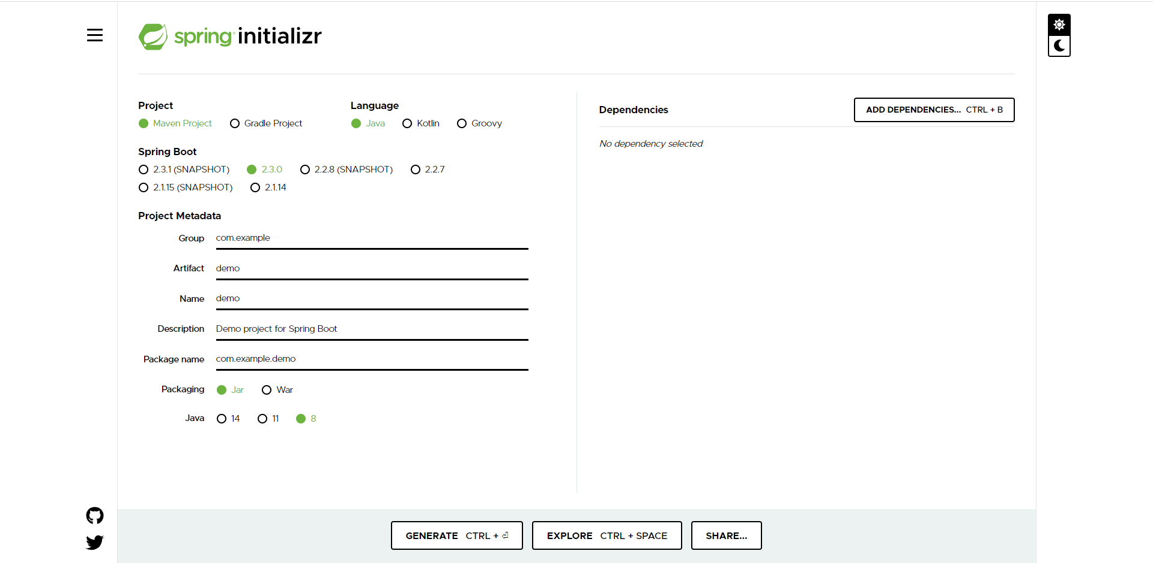
Spring Initializer
The Spring Initializr is ultimately a web application that can generate a Spring Boot project structure.
Does not generate any application code, but provides the basic project structure
The Initializr offers a fast way to pull in all the dependencies you need for an application and does a lot of the setup
https://start.spring.io/

Slide 24
Creating our First REST Web Service
Open Spring Initializr
Select the following:
Project: Maven
Language: Java
Spring Boot: 2.3.0 (any)
Project Metadata:
Group: com.ibm.sdet.training
Artifact: RestServiceExample
Name: RestServiceExample
Description: Demo project for Rest Web Service
Package Name: com.ibm.sdet.training.RestServiceExample
Packaging: JAR
Java: 8
Dependencies:
Spring Web

Slide 25
Creating our First REST Web Service
Group: project coordinates (id of the project’s group, as referred by the groupId attribute in Apache Maven). Also infers the root package name to use.
Artifact: project coordinates (id of the artifact, as referred by the artifactId attribute in Apache Maven). Also infers the name of the project
Name: display name of the project that also determines the name of your Spring Boot application. For instance, if the name of your project is my-app, the generated project will have a MyAppApplication class
Description: description of the project
Package Name: root package of the project. If not specified, the value of the Group attribute is used
Packaging: project packaging (as referred by the concept of the same name in Apache Maven). start.spring.io can generate jar or war projects
Java: the Java version to use

Slide 26
Spring Annotations
@RestController - is used to create RESTful web services using Spring MVC. Spring RestController takes care of mapping request data to the defined request handler method. Once response body is generated from the handler method, it converts it to JSON or XML response.
@RequestMapping - maps HTTP requests to handler methods of MVC and REST controllers. The @RequestMapping annotation can be applied to class-level and/or method-level in a controller.
Spring currently supports five types of inbuilt annotations for handling different types of incoming HTTP request methods which are GET, POST, PUT, DELETE and PATCH. These annotations are:
@GetMapping
@PostMapping
@PutMapping
@DeleteMapping
@PatchMapping

Slide 27
Spring Annotations
@PathVariable
annotation to extract any value which is embedded in the URL itself.
@RequestBody
annotation maps the HttpRequest body to a transfer or domain object, enabling automatic deserialization of the inbound HttpRequest body onto a Java object.
@Component
is the most generic Spring annotation. A Java class decorated with @Component is found during classpath scanning and registered in the context as a Spring bean. Spring only pick up and registers beans with @Component
@Autowired
The @Autowired annotation allows you to skip configurations elsewhere of what to inject and just does it for you. The @Autowired annotation spares you the need to do the wiring by yourself in the XML file (or any other way) and just finds for you what needs to be injected where, and does that for you.

Slide 28
Inversion of Control (IoC)
Inversion of Control is a principle in software engineering by which the control of objects or portions of a program is transferred to a container or framework. It's most often used in the context of object-oriented programming.
IoC enables a framework to take control of the flow of a program and make calls to our custom code.
The advantages of this architecture are:
decoupling the execution of a task from its implementation
making it easier to switch between different implementations
greater modularity of a program
greater ease in testing a program by isolating a component or mocking its dependencies and allowing components to communicate through contracts
Inversion of Control can be achieved through various mechanisms such as: Strategy design pattern, Service Locator pattern, Factory pattern, and Dependency Injection (DI).

Slide 29
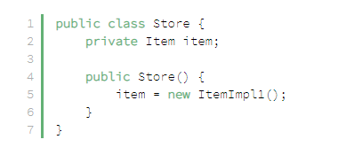
Dependency Injection
Dependency injection is a pattern through which to implement IoC, where the control being inverted is the setting of object's dependencies.
The act of connecting objects with other objects, or “injecting” objects into other objects, is done by an assembler rather than by the objects themselves.
Here's how you would create an object dependency in traditional programming:

Slide 30
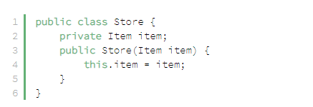
Dependency Injection (DI)
In the previous example, we need to instantiate an implementation of the Item interface within the Store class itself.
By using DI, we can rewrite the example without specifying the implementation of Item that we want:

Slide 31
Rest Web Services
We will be creating a simple application with CRUD operations throughout our sessions:
Retrieve all users
Create a user
Retrieve single user
Delete a user
Update a user
Notes:
Retrieve all users -- GET /users
Create a user -- POST /users
Retrieve single user -- POST /users/{id}
Delete a user -- DELETE /users/{id}
Retrieve all posts for a user -- GET /users/{id}/posts
Create a post for a user -- POST /users/{id}/posts
Retrieve details of a post -- GET /users/{id}/posts/{post_id}

Slide 32
Creating Swagger Documentation
Add dependencies in pom.xml
Maven
<dependency>
<groupId>io.springfox</groupId>
<artifactId>springfox-swagger2</artifactId>
<version>2.4.0</version>
</dependency>
<dependency>
<groupId>io.springfox</groupId>
<artifactId>springfox-swagger-ui</artifactId>
<version>2.4.0</version>
</dependency>
Gradle
compile group: 'io.springfox', name: 'springfox-swagger2', version: '2.4.0'
compile group: 'io.springfox', name: 'springfox-swagger-ui', version: '2.4.0'
Configure your application to produce a swagger documentation
Create a new class called SwaggerConfig.java
Add @Configuration & @EnableSwagger2 annotation on class level
Create a bean and a method called api – should return a Docket instance
Add logging.level.web=TRACE in your application.properties for additiona logging info (Optional)
Run application
Access localhost:8080/swagger-ui-html

Slide 33
Implementing Static Filtering for REST Web Services
@JsonIgnore
the @JsonIgnore annotation marks a field in a POJO to be ignored by Jackson during serialization and deserialization. Jackson ignores the field in both JSON serialization and deserialization.
@JsonIgnoreProperties
The @JsonIgnoreProperties annotation is used at the class level to ignore fields during serialization and deserialization.

Slide 34
Introduction to Java Persistence API (JPA)
Java Persistence API is a collection of classes and methods to persistently store the vast amounts of data into a database which is provided by the Oracle Corporation.
JPA is not a tool or framework; rather, it defines a set of concepts that can be implemented by any tool or framework.
JPA is a standard for Object Relational Mapping.

Slide 35
Introduction to Java Persistence API (JPA)
Object Relational Mapping
Object Relational Mapping (ORM) briefly tells you about what is ORM and how it works. ORM is a programming ability to convert data from object type to relational type and vice versa.
is a technique that lets you query and manipulate data from a database using an object-oriented paradigm.
The main feature of ORM is mapping or binding an object to its data in the database. While mapping we have to consider the data, type of data and its relations with its self-entity or entity in any other table.
The Object part is the one you use with your programming language ( java in this case )
The Relational part is a Relational Database Manager System ( A database that is ) there are other types of databases but the most popular is relational ( you know tables, columns, pk fk etc eg Oracle MySQL, MS-SQL )
And finally the Mapping part is where you do a bridge between your objects and your tables.

Slide 36
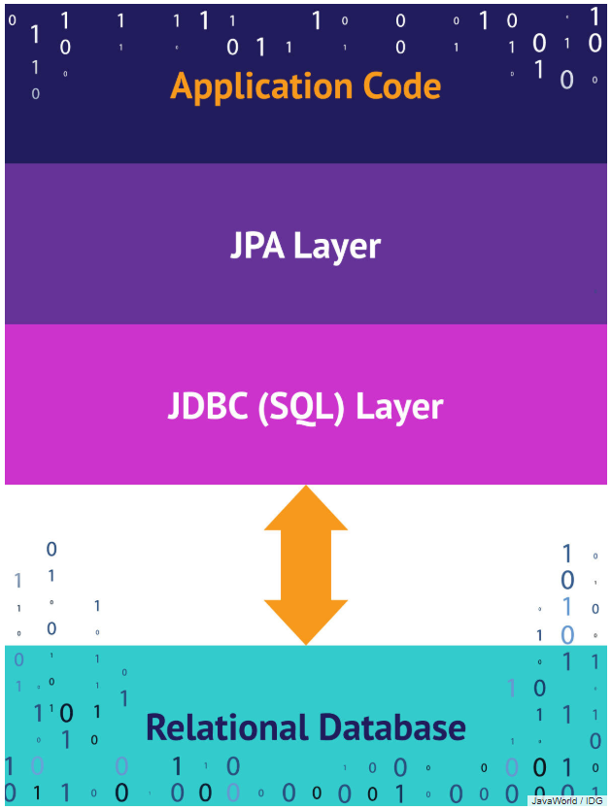
Introduction to Java Persistence API (JPA)
asdasd

Slide 37
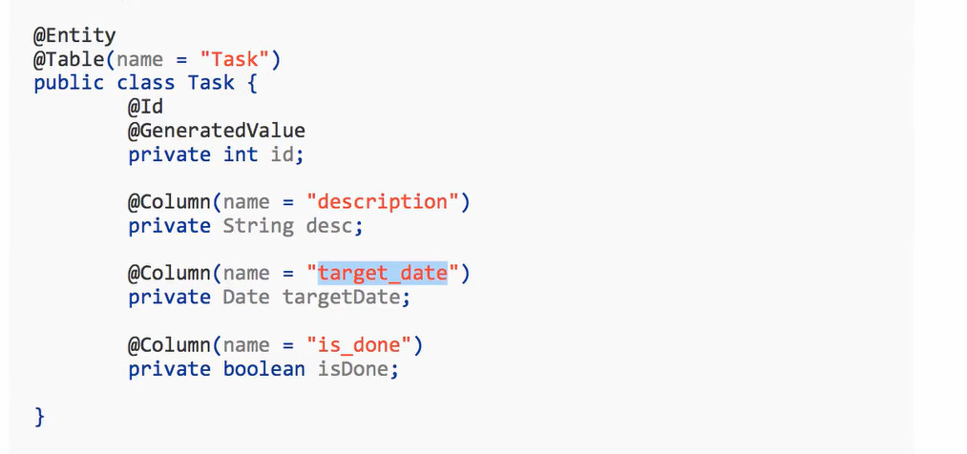
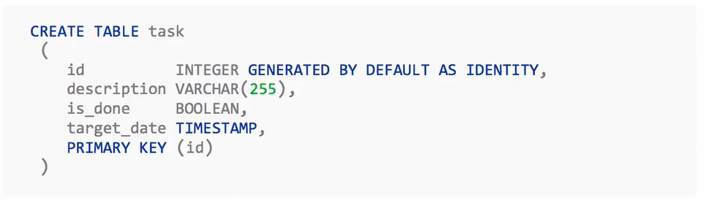
Introduction to Java Persistence API (JPA)

Slide 38
Introduction to Java Persistence API (JPA)
Now, let’s create a new project using Spring Initialzr.
Complete the Project Metadata form.
Add these dependencies
Spring Web
Spring JPA
H2 (Inline Memory Database)

Slide 39
Introduction to Java Persistence API (JPA)
@Entity
Entities in JPA are nothing but POJOs representing data that can be persisted to the database. An entity represents a table stored in a database. Every instance of an entity represents a row in the table.
@Table(name = “TableName”)
Provide a custom table name for the database
@Id
Defines the Primary Key
@GeneratedValue
Defines that the primary key wil have a auto generated value
@Column
@Column annotation to mention the details of a column in the table. The @Column annotation has many elements such as name, length, nullable, and unique.

Slide 40
Introduction to Java Persistence API (JPA)
@Repository
@Repository is a Spring annotation that indicates that the decorated class is a repository. A repository is a mechanism for encapsulating storage, retrieval, and search behavior which emulates a collection of objects.
@Transactional
The transactional annotation itself defines the scope of a single database transaction. The database transaction happens inside the scope of apersistence context.
@PersistenceContext
A persistence context is a set of entities such that for any persistent identity there is a unique entity instance. Within a persistence context, entities are managed. The EntityManager controls their lifecycle, and they can access datastore resources.

Slide 41
Introduction to Java Persistence API (JPA)
H2 – Memory Database
Where is the Database created?
In Memory – Using H2
What schema is used to create the tables?
Created based on the entities defined
Can I see the database data?
http://localhost:8080/h2-console
Use db url jdbc:h2:mem:testdb
Where is Hibernate coming from?
Through Spring Data JPA Starter
How is Datasource created?
Through Spring Boot Auto Configuration

Slide 42
Introduction to Spring Data JPA
Spring Data JPA, part of the larger Spring Data family, makes it easy to easily implement JPA based repositories.
Implementing a data access layer of an application has been cumbersome for quite a while. Too much boilerplate code has to be written to execute simple queries as well as perform pagination, and auditing.
Spring Data JPA aims to significantly improve the implementation of data access layers by reducing the effort to the amount that’s actually needed. As a developer you write your repository interfaces, including custom finder methods, and Spring will provide the implementation automatically.

